Slide 1
Mutual Fund Portfolio Application
By POC Team 1

Slide 2
Sprint 0
Backlog Items
Class Diagram
Flow Diagram
Admin Page
User home page
Invest Page
Redeem Page
Architecture Diagram
Environment set-up
Git
Jenkins
Log configuration

Slide 3
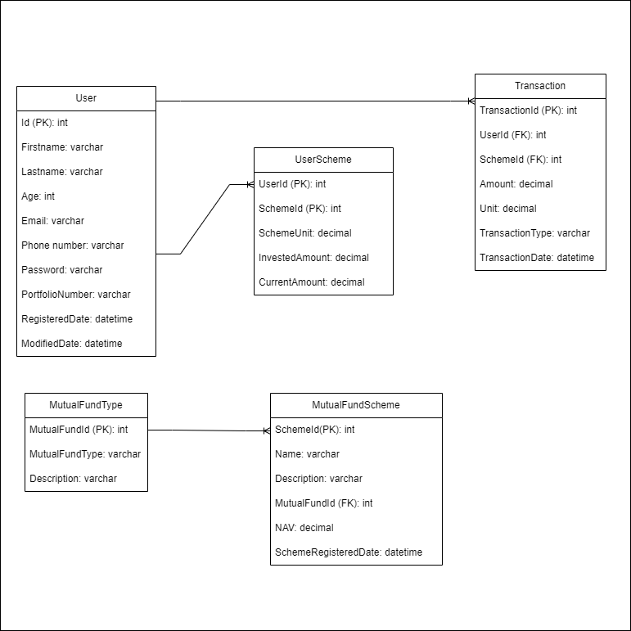
Class Diagram

Slide 4
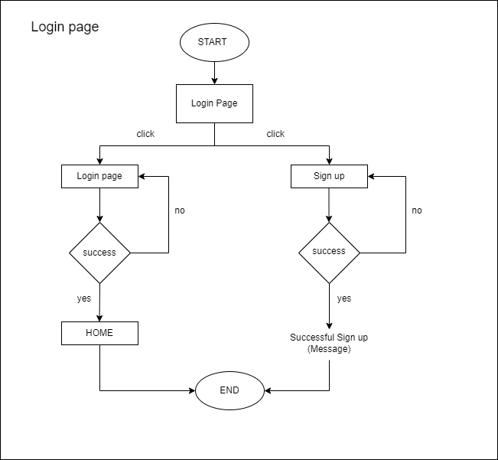
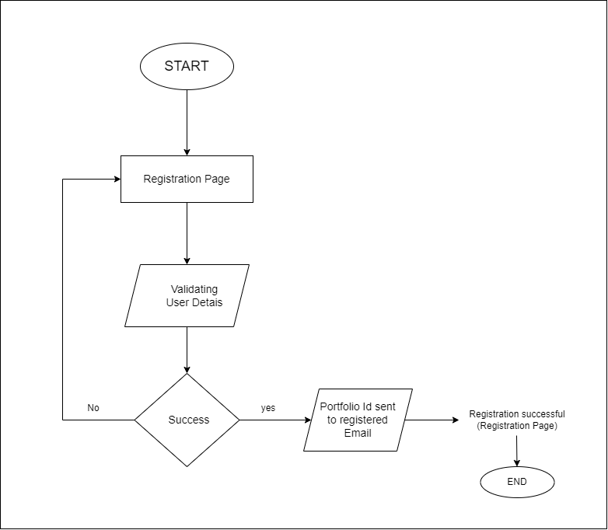
Flow Diagram
Login page
Registration Page

Slide 5
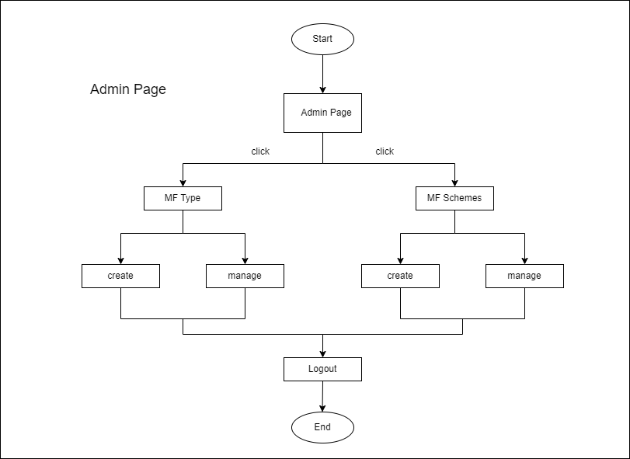
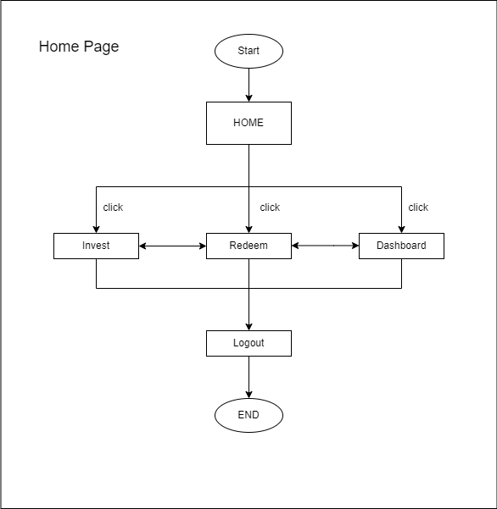
Admin Page
Home Page

Slide 6
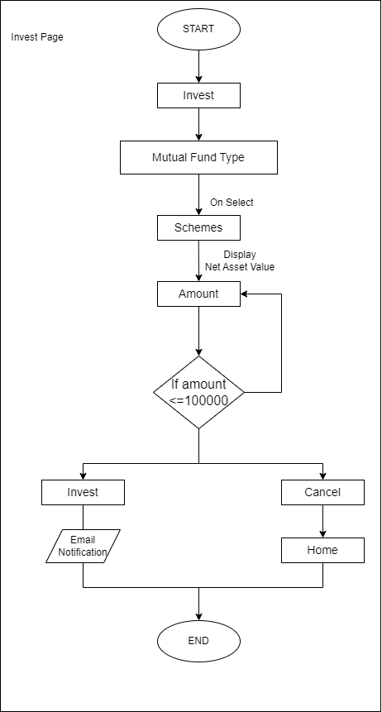
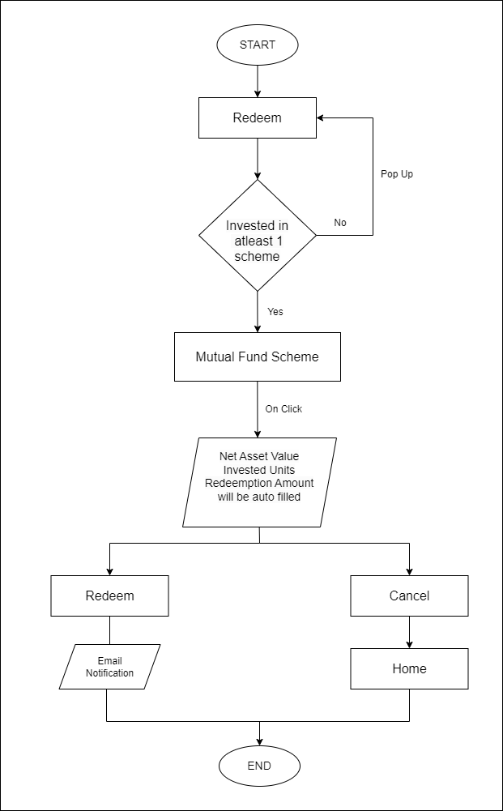
Invest Page
Redeem Page

Slide 7

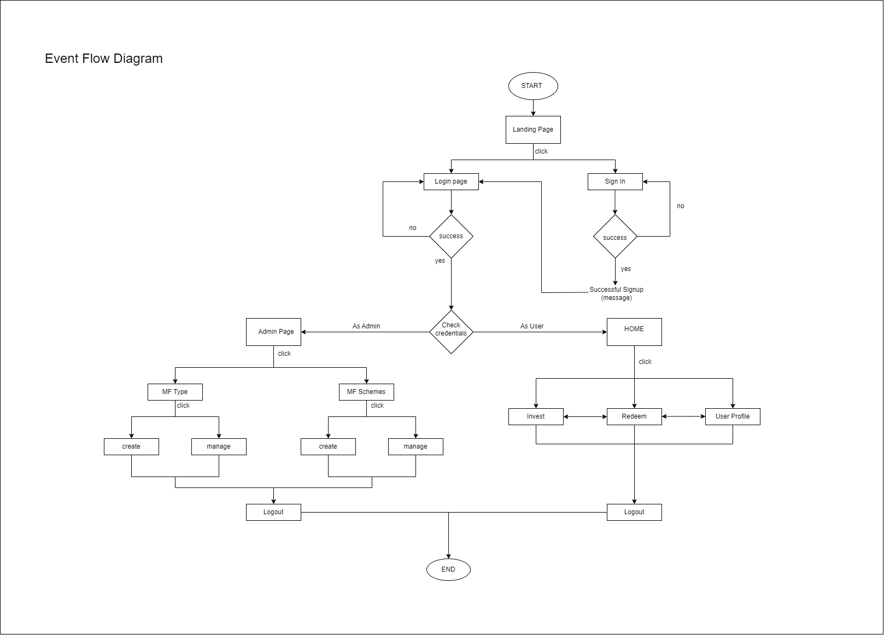
Event Flow Diagram

Slide 8
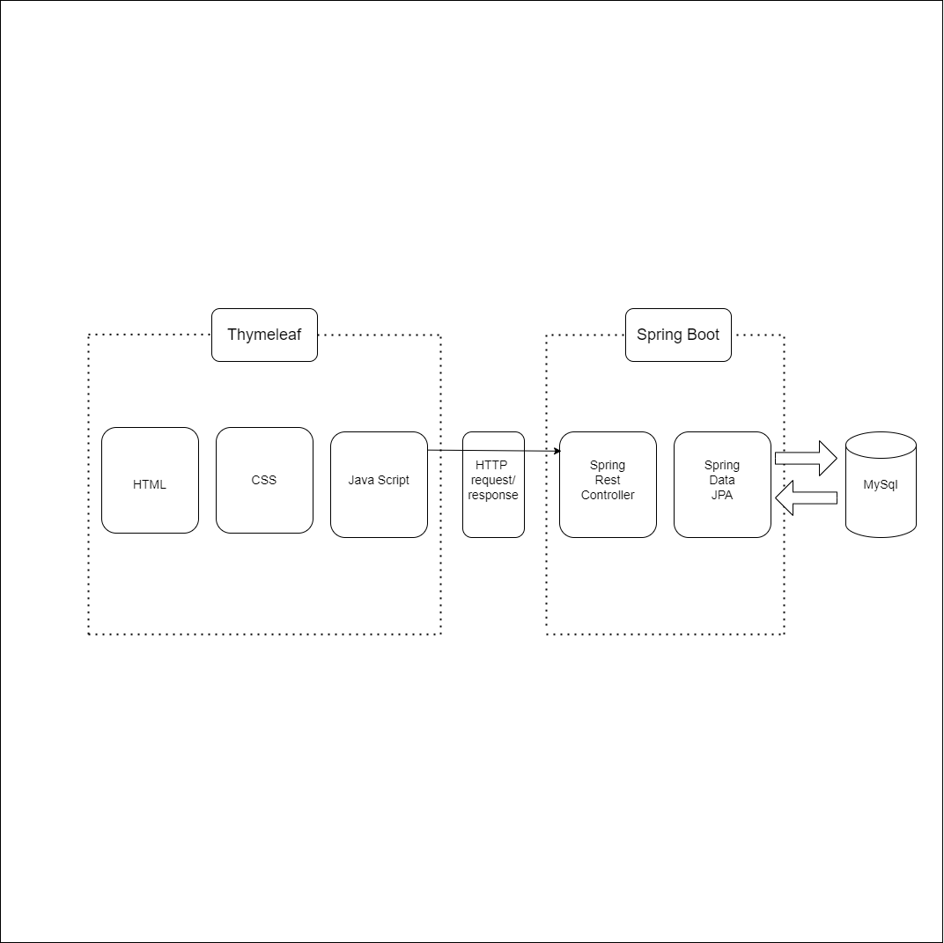
Architecture Diagram

Slide 9
Technology Stack
Front-end
Thymeleaf (HTML, CSS, JavaScript, jQuery)
Back-end
Database : MySQL
ORM : Spring JPA
Framework : Spring-Boot 3.1.6, Java 17
IDE : Eclipse
Build Tool
Maven
Version Control
Git
Deployment
Jenkins 2.414 and Tomcat 10.1.16
Logging
LogBack 1.2.6

Slide 10

Final Demo
Backlog Items
z
Landing Page
Login Page
Register Page
Email Template
Admin Page
Home Page
Invest Page
Redeem Page
User Profile

Slide 11

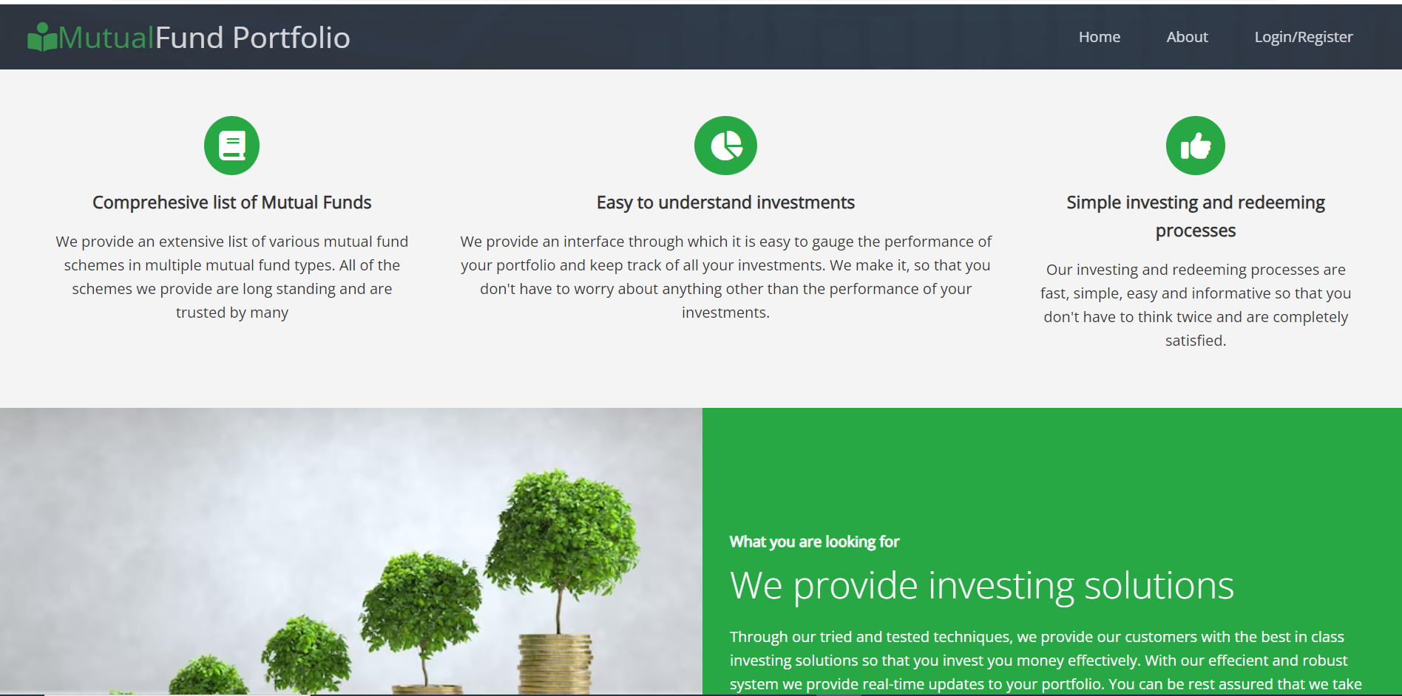
Landing Page

Slide 12
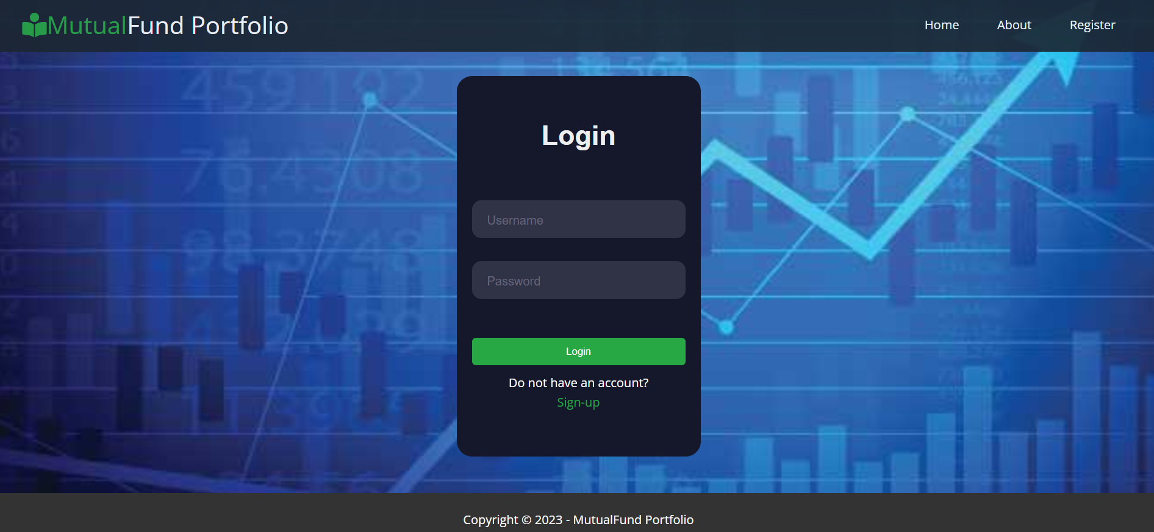
Login Page

Slide 13

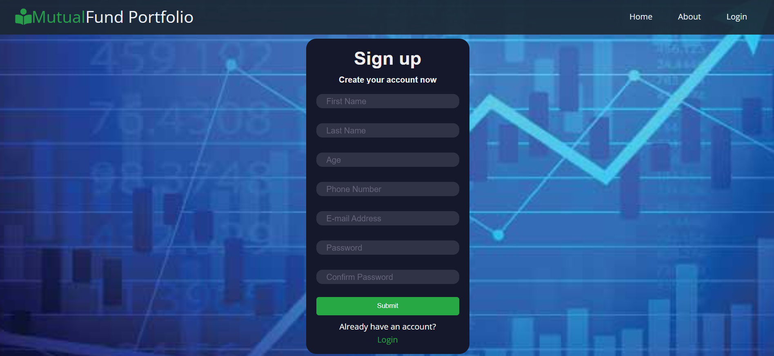
z
Registration Page

Slide 14
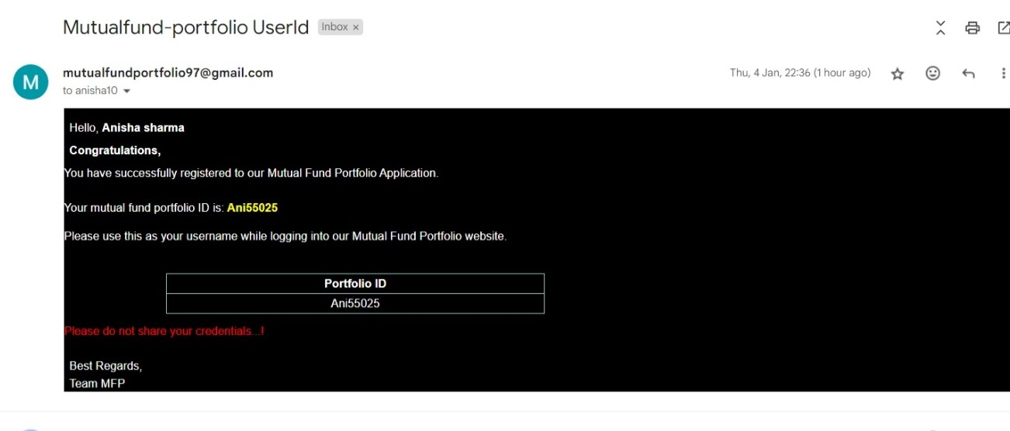
Email Template

Slide 15
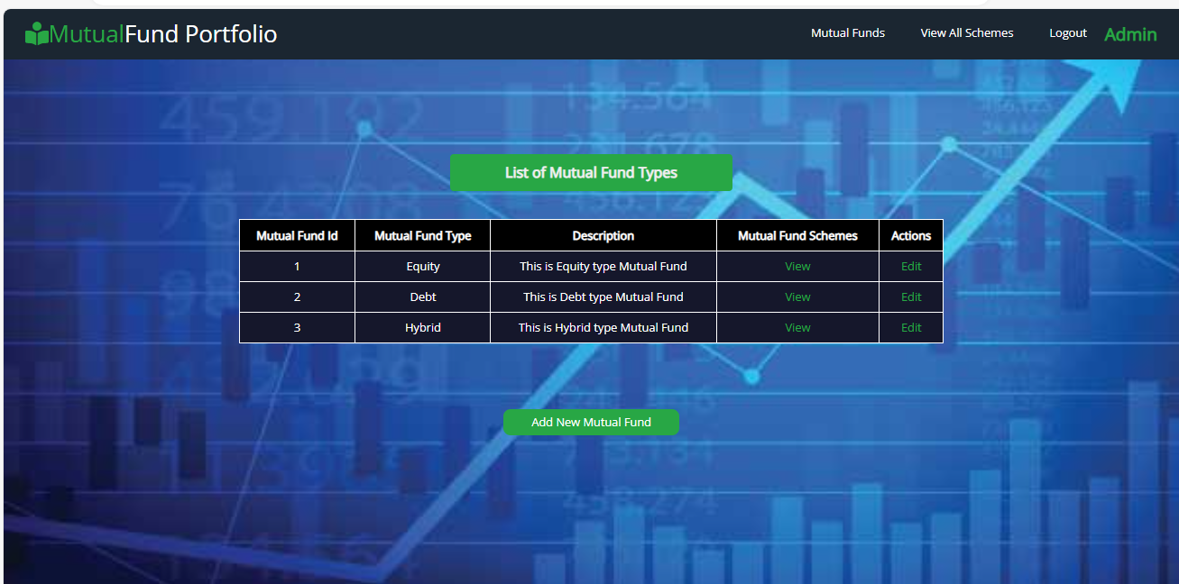
Admin Page
List of Mutual Fund Types

Slide 16
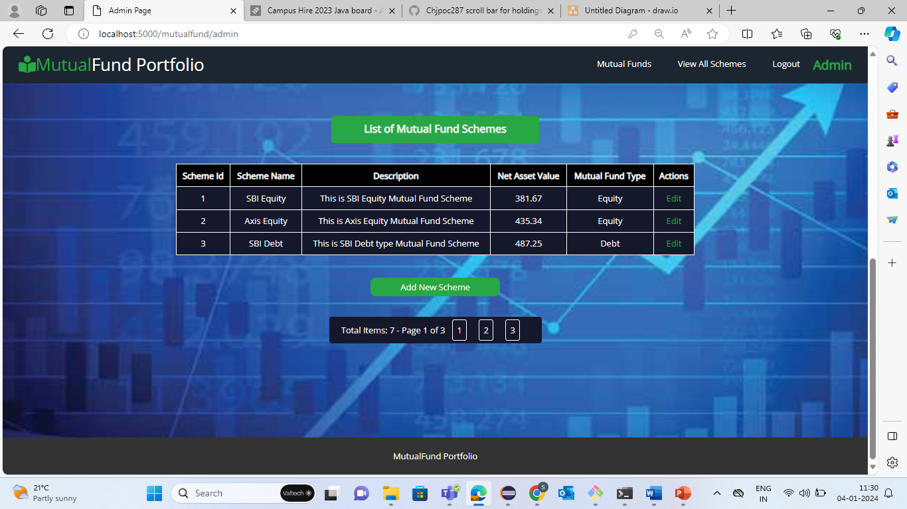
List of all Mutual Fund Schemes

Slide 17
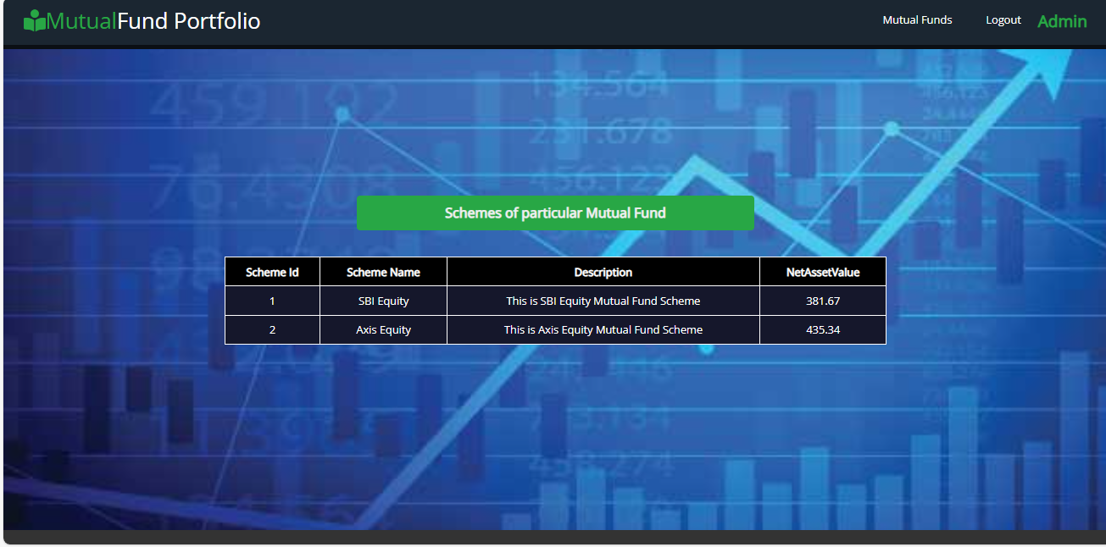
List of schemes related to a particular Mutual Fund

Slide 18
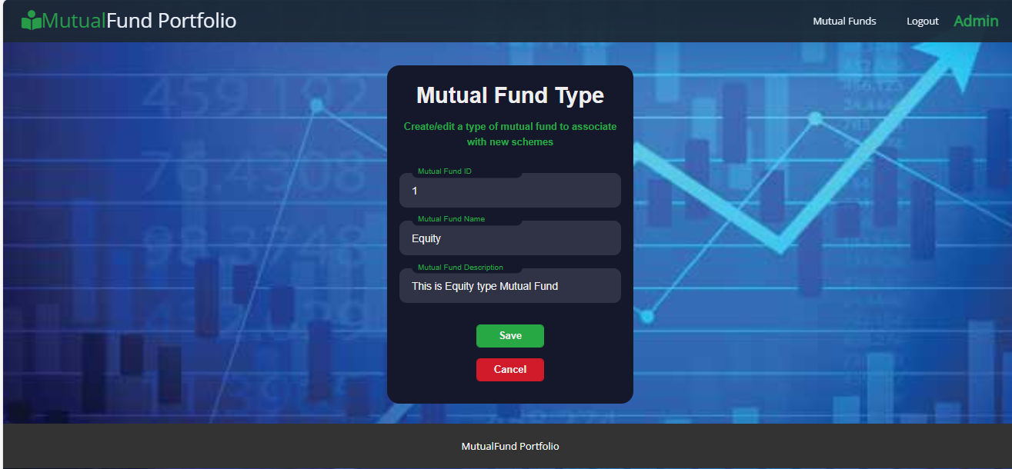
Edit and Add New Mutual Fund

Slide 19
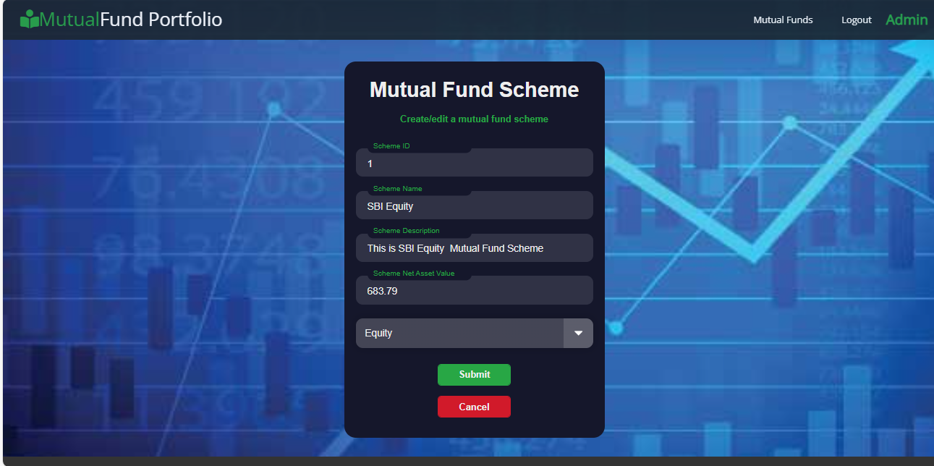
Edit and Add New Mutual Fund Scheme

Slide 20
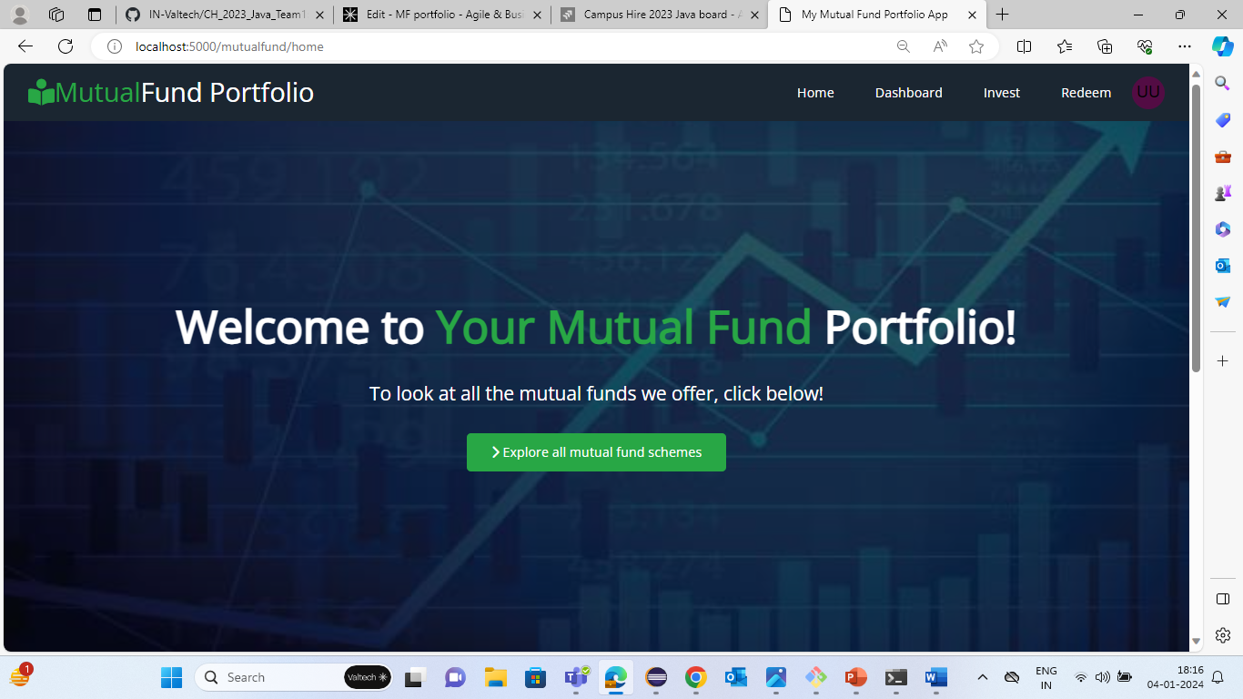
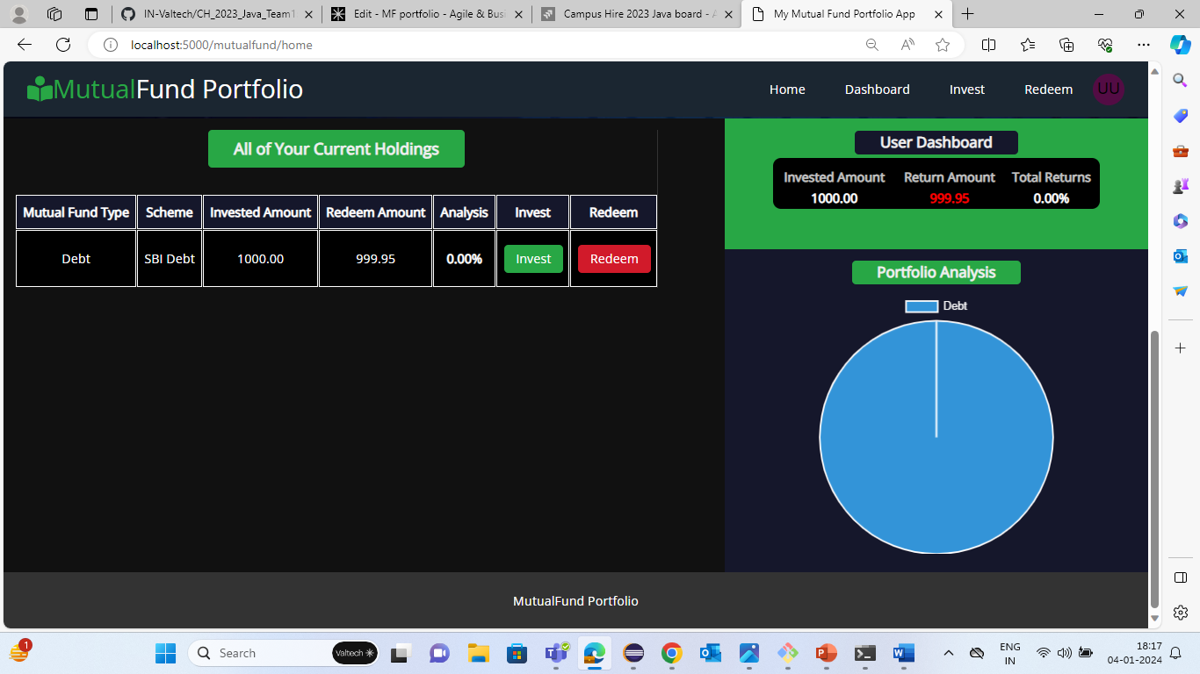
Home Page

Slide 21
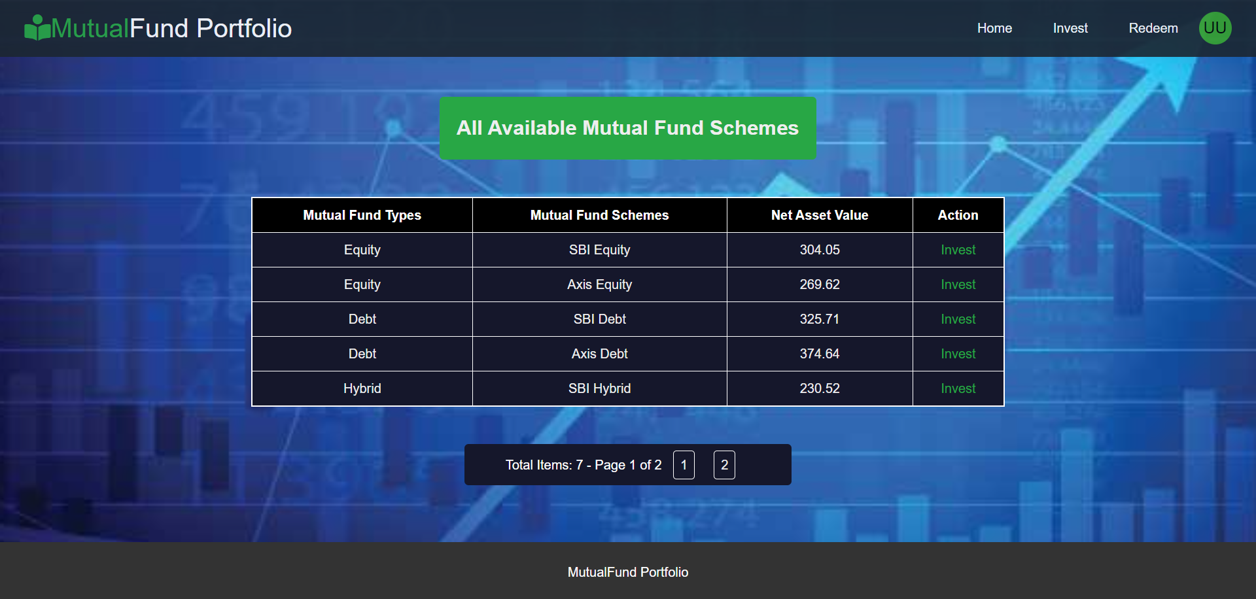
Explore Page
Explore Page

Slide 22
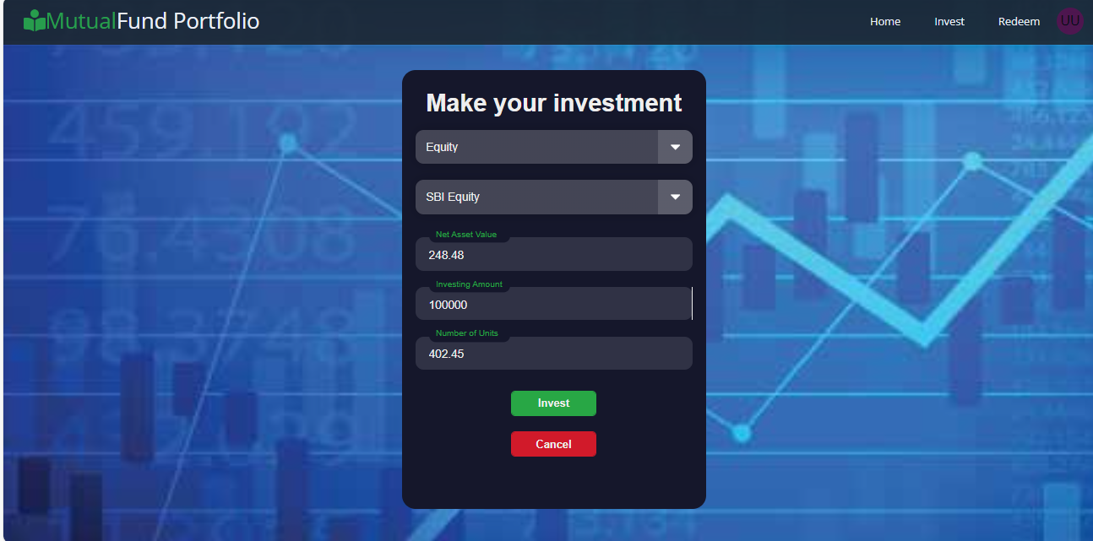
Invest Page

Slide 23
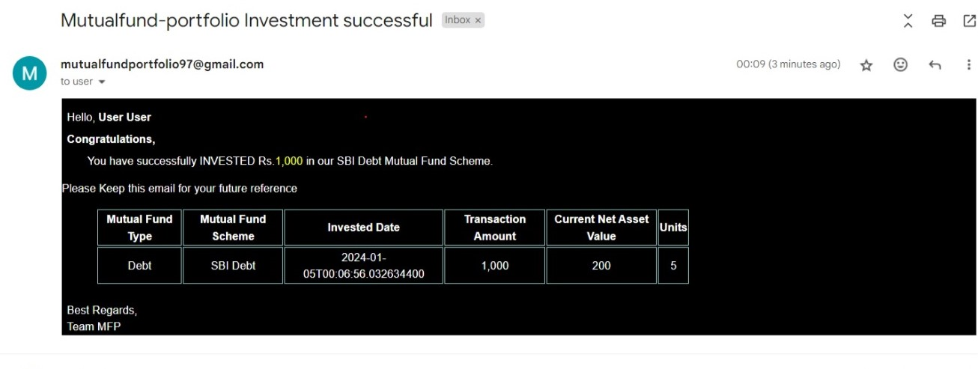
Investment email Template

Slide 24
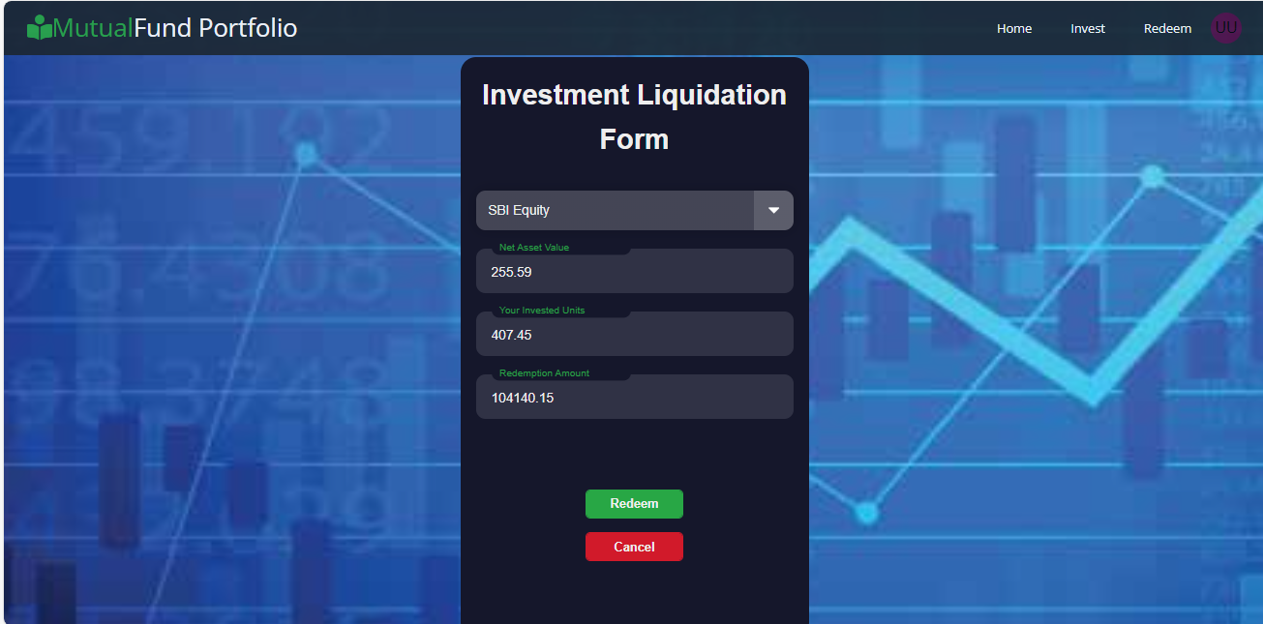
Redeem Page

Slide 25
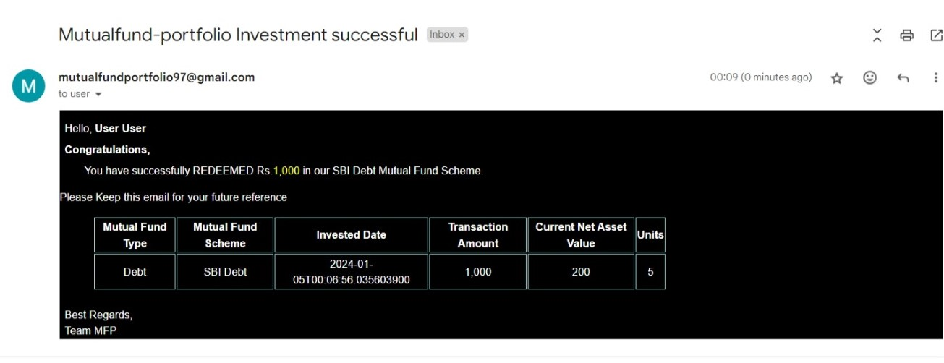
Redeem Email Template

Slide 26
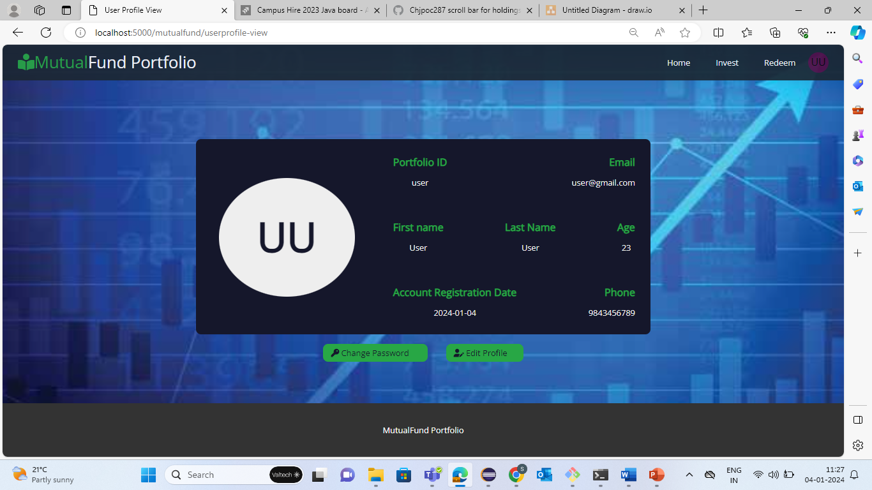
User Profile

Slide 27
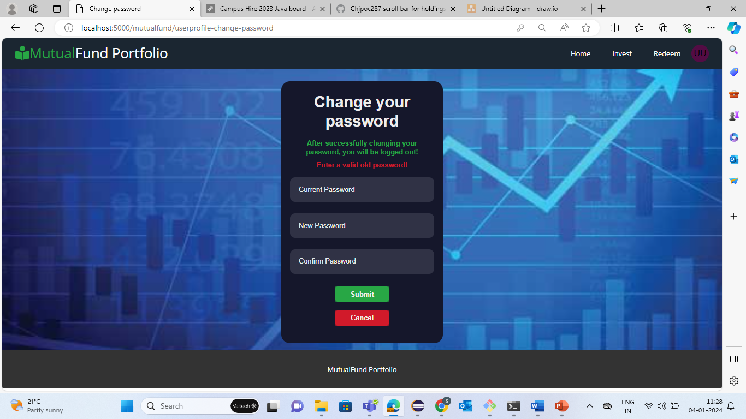
Change Password

Slide 28
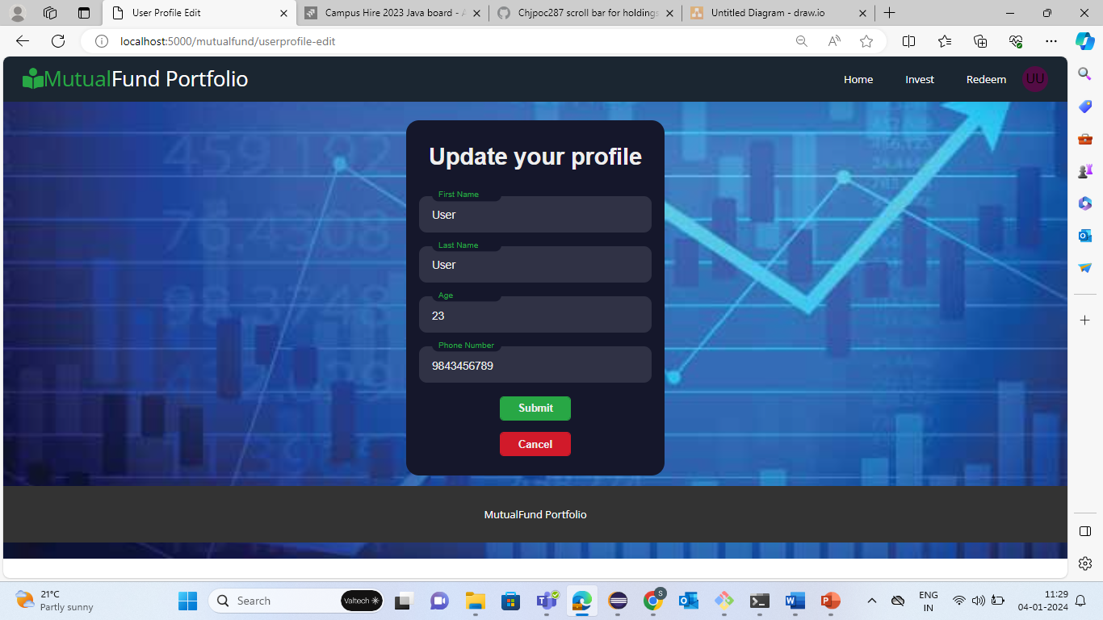
Edit Profile

Slide 29
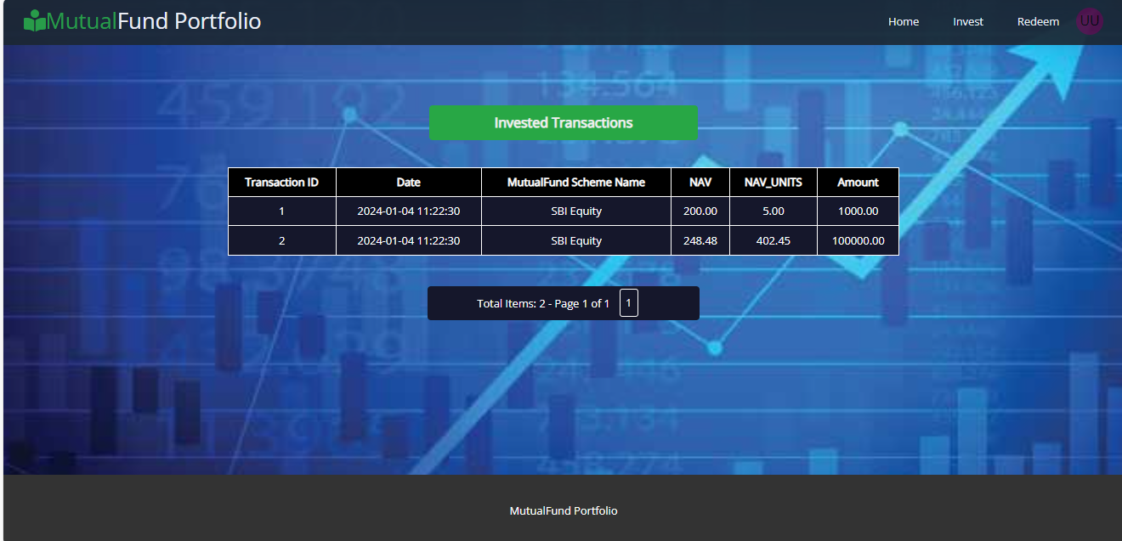
Investment Transactions

Slide 30
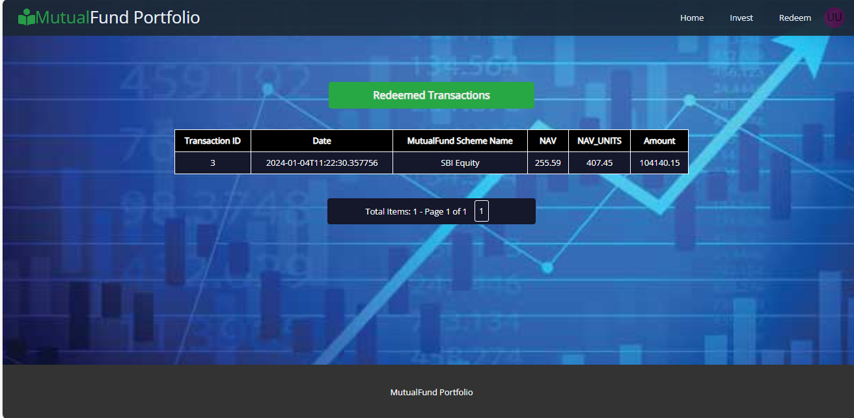
Redeemed Transactions

Slide 31

Thank You
z

